Slide 1

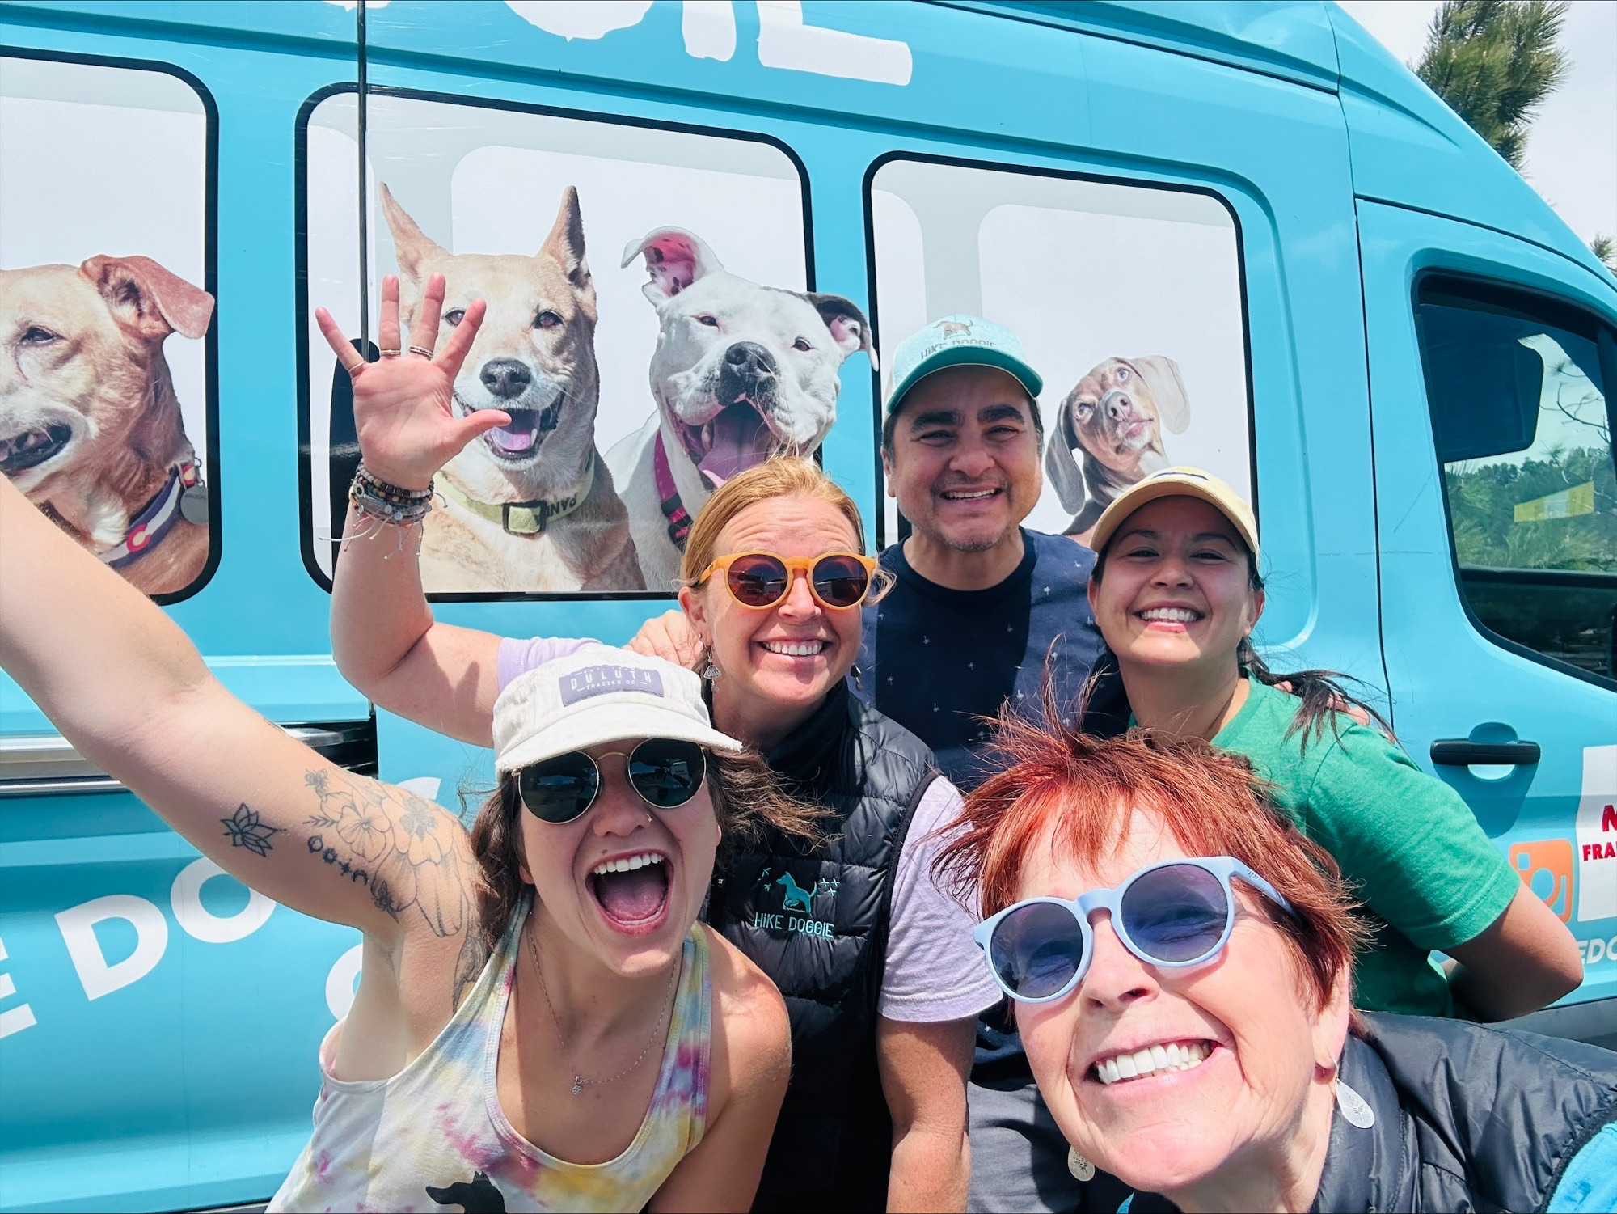
We make dogs as happy as they make us.
ONLY Dog Hiking Franchise
Huge need for more dog activities in the marketplace
Dog hiking currently takes place across the U.S.
Convenient door-to-door service
91% Recurring Weekly Revenue
Low-Cost Start-Up
Low Overhead
Mobile Home-Based Business
Fully wrapped & upfitted Hike Doggie bus delivered in 30 days
Start ‘Barketing’ & building client base quickly
Owner Operator or Multi Unit opportunity
Hiring is Easy, No Need for Specialized Skills
Exceptional Training, Support & Marketing
By a team that has conducted over 50,000 dog hikes
Third-Party Financing

Slide 2
Hike Doggie Business Basics
Industry
Royalty
Brand Marketing
Initial Investment
Item 19
Training
Franchise Fee
Pet & Home-Based Service
In-Person In Golden, CO
$45,000
8%
2%
$94,450 - $213,800
Yes
Business Units
AR
Available
Protected Territory Size
Liquid Capital
Employees Required
Financing
Support
Yes - Approx. 125K Population
Yes - 3rd Parties & SBA Approved
On-Going Training & Marketing
9
Yes
$100,000
3

Slide 3

Business Features 1
Recurring Weekly Revenue Model
Hiring is Easy
Simple Business Model
No need to hire individuals with specialized skills
We hiked dogs – period!
No inventory. No SKUs.
Allows franchisees to master their service.
91% recurring weekly revenue

Slide 4

Business Features 2
Regional Franchise Opportunity
No Location Lease To Sign
Training & Support
Real world training & support provided by our corporate team with a combined 50 years’ experience in running a successful Hike Doggie business, obtaining & retaining clients and hiking dogs safely.
Area Representative model available
Home-based businesses have lower operating costs

